Slide 1
SFIRE: Secret-Free In-band Trust Establishment for COTS Wireless Devices
IEEE INFOCOM 2018 - IEEE Conference on Computer Communications

Slide 2
Introduction
A novel PHY-layer primitive called SFIRE that prevents rogue devices from joining the network by “RSS authenticator”
A secure in-band pairing protocol based on the Diffie-Hellman (DH) key agreement.
SFIRE is interoperable with any commercial off-the-shelf (COTS) device that has a common wireless interface with the hub.

Slide 3
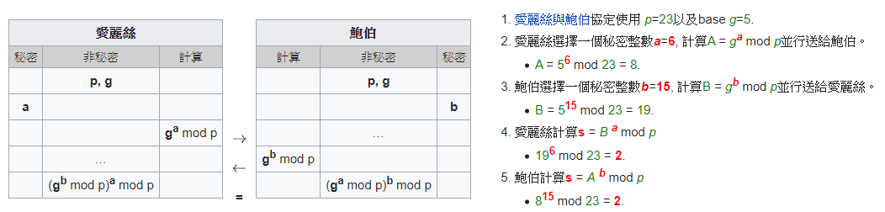
Diffie-Hellman
可以讓雙方在完全沒有對方任何預先資訊的條件下通過不安全通道建立起一個金鑰

Slide 4
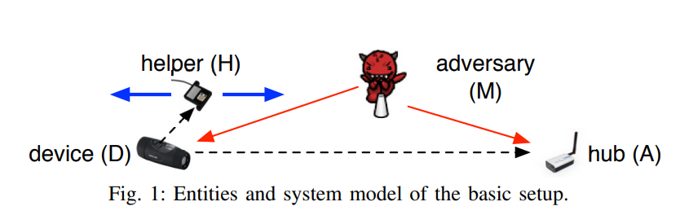
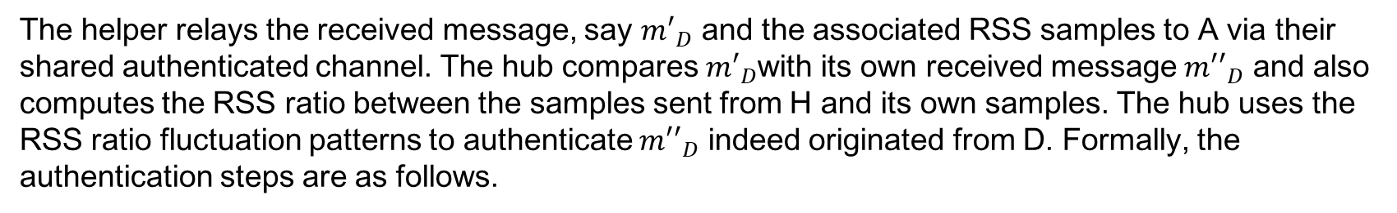
RSS Authenticator
Remote Sensing Systems Authenticator
The helper relays the received message, say ${m′}_{D}$ and the associated RSS samples to A via their shared authenticated channel. The hub compares ${m′}_{D}$with its own received message ${m′′}_{D}$ and also computes the RSS ratio between the samples sent from H and its own samples. The hub uses the RSS ratio fluctuation patterns to authenticate ${m′′}_{D}$ indeed originated from D. Formally, the authentication steps are as follows.

Slide 5
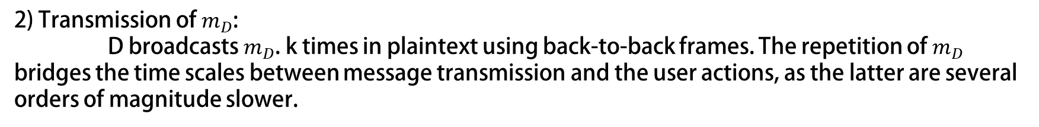
Constructing an RSS Authenticator
Initialization:
The user presses a button on D or simply switches D on to set it to pairing mode. The user then presses a button or a virtual button on H to initiate the protocol. H sends an authenticated request-to-communicate message to A using the AE(·) function, which attests that D is present. The hub starts a timer.
2) Transmission of $m_{D}$:
D broadcasts $m_{D}$. k times in plaintext using back-to-back frames. The repetition of $m_{D}$ bridges the time scales between message transmission and the user actions, as the latter are several orders of magnitude slower.
Notes:
步驟一: 將device D 設為配對模式，再開啟helper H 並使H與A利用AE function達到時間同步。
步驟二: D傳送$k次m_{D}$message

Slide 6
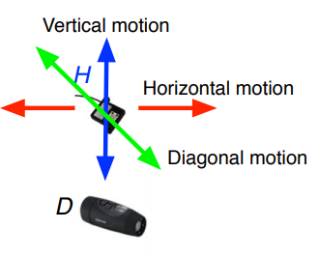
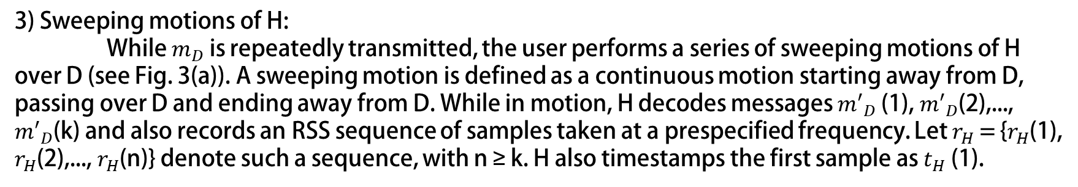
3) Sweeping motions of H:
While $m_{D}$ is repeatedly transmitted, the user performs a series of sweeping motions of H over D (see Fig. 3(a)). A sweeping motion is defined as a continuous motion starting away from D, passing over D and ending away from D. While in motion, H decodes messages ${m′}_{D}$(1), ${m′}_{D}$(2),..., ${m′}_{D}$(k) and also records an RSS sequence of samples taken at a prespecified frequency. Let $r_{H}$ = {$r_{H}$(1), $r_{H}$(2),..., $r_{H}$(n)} denote such a sequence, with n ≥ k. H also timestamps the first sample as $t_{H}$(1).
4) Reception at $m_{D}$ at A:
The hub decodes ${m′′}_{D}$(1), ${m′′}_{D}$(2) ,..., ${m′′}_{D}$(k) while the k $m_{D}$s are being transmitted by D. The hub also records $r_{A}$ = {$r_{A}$(1), $r_{A}$(2), ..., $r_{A}$(n)}, and the reception time $t_{A}$(1) of the first sample.
Notes:
步驟三: 當$m_{D}$重複被傳送的同時，H會做sweeping的動作，會有三種方向:水平 垂直以及對角。H在做sweeping動作同時也會去decode每個 ${m′}_{D}$，也會記錄當下收到時的RSS，並存成$r_{H}$ 陣列，還有紀錄時間。
步驟四: 當A收到D傳來的每$個{m′′}_{D} 時$，也會做decode的動作，也記錄當下的RSS並存成陣列$r_{A}$

Slide 7
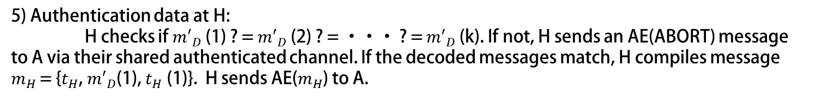
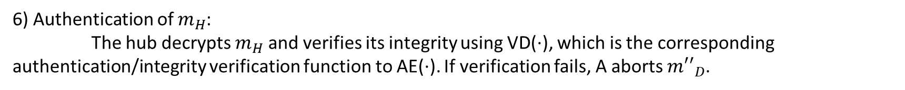
5) Authentication data at H:
H checks if ${m′}_{D}$(1) ? = ${m′}_{D}$(2) ? = ··· ? = ${m′}_{D}$(k). If not, H sends an AE(ABORT) message to A via their shared authenticated channel. If the decoded messages match, H compiles message $m_{H}$ = {$t_{H}$, ${m′}_{D}$(1), $t_{H}$ (1)}. H sends AE($m_{H}$) to A.
6) Authentication of $m_{H}$:
The hub decrypts $m_{H}$ and verifies its integrity using VD(·), which is the corresponding authentication/integrity verification function to AE(·). If verification fails, A aborts ${m′′}_{D}$.
Notes:
步驟五: H要確定每個收到的${m′}_{D}$都相同，若不同會傳送AE(ABORT)給 A(經由他們已建立的認證通道)，若每個${m′}_{D}$都相同就將${(r}_{H}，{m′}_{D}$(1)，$t_{H}(1)$)包成$m_{H}傳送給$A
步驟六: A收到$m_{H}$會進行解密，並進行確認，若失敗則捨棄自己由D方送出的${m′′}_{D}$。

Slide 8

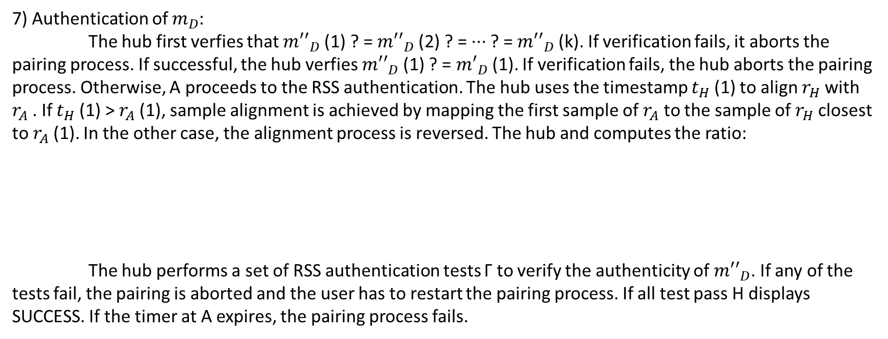
7) Authentication of $m_{D}$:
The hub first verfies that ${m′′}_{D}$(1) ? = ${m′′}_{D}$(2) ? = ··· ? = ${m′′}_{D}$(k). If verification fails, it aborts the pairing process. If successful, the hub verfies ${m′′}_{D}$(1) ? = ${m′}_{D}$(1). If verification fails, the hub aborts the pairing process. Otherwise, A proceeds to the RSS authentication. The hub uses the timestamp $t_{H}$(1) to align $r_{H}$ with $r_{A}$. If $t_{H}$(1) > $r_{A}$(1), sample alignment is achieved by mapping the first sample of $r_{A}$ to the sample of $r_{H}$ closest to $r_{A}$(1). In the other case, the alignment process is reversed. The hub and computes the ratio:
The hub performs a set of RSS authentication tests Γ to verify the authenticity of ${m′′}_{D}$. If any of the tests fail, the pairing is aborted and the user has to restart the pairing process. If all test pass H displays SUCCESS. If the timer at A expires, the pairing process fails.
Notes:
最後在A端 要確認每個收到的${m‘’}_{D}是$否相同，若不相同則pair失敗，若都相同，則比較${m′′}_{D}$(1)是否等於${m′}_{D}$(1)，若不同則pair失敗。若相同就會進行RSS的認證，利用$t_{H}$(1)來對齊$r_{H}$與$r_{A}\text{(}\text{H}\text{收到}{m′′}_{D}\text{所記錄的}\text{RSS}\text{)}$與(A收到${m‘’}_{D}$所記錄的RSS)。然後紀錄兩個RSS的比值 並存成Gamma陣列
接下來就是要進行一連串RSS認證的測試，若是通過了則pair成功，若其中一個不通過或超時則失敗。

Slide 9
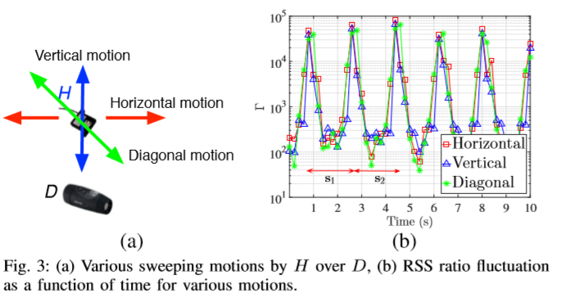
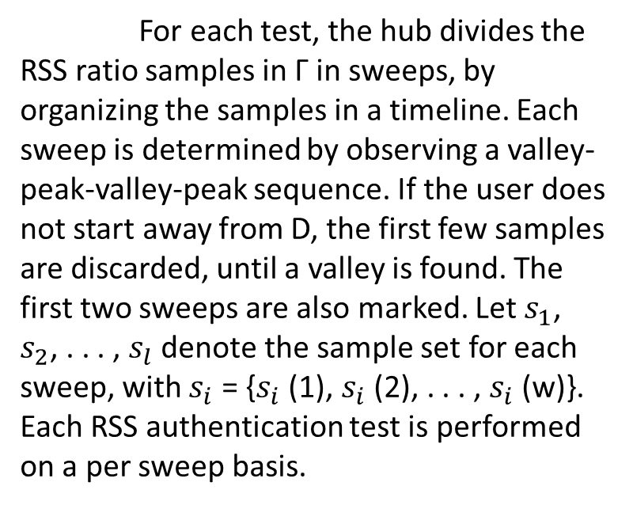
RSS Authentication Tests
For each test, the hub divides the RSS ratio samples in Γ in sweeps, by organizing the samples in a timeline. Each sweep is determined by observing a valley-peak-valley-peak sequence. If the user does not start away from D, the first few samples are discarded, until a valley is found. The first two sweeps are also marked. Let${ s}_{1}$, $s_{2}$, . . . , $s_{l}$ denote the sample set for each sweep, with $s_{i}$ = {$s_{i}$ (1), $s_{i}$ (2), . . . , $s_{i}$ (w)}. Each RSS authentication test is performed on a per sweep basis.
Notes:
整個RSS Authentication Tests在A端進行，利用sweep將整個Γ做分隔。

Slide 10
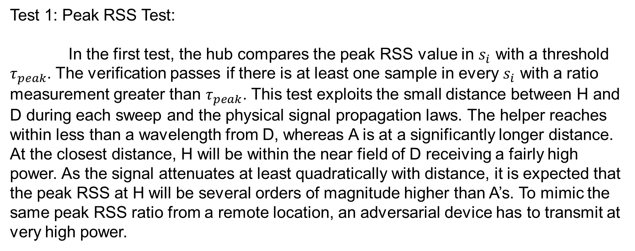
Test 1: Peak RSS Test:
In the first test, the hub compares the peak RSS value in $s_{i}$ with a threshold $τ_{peak}$. The verification passes if there is at least one sample in every $s_{i}$ with a ratio measurement greater than $τ_{peak}$. This test exploits the small distance between H and D during each sweep and the physical signal propagation laws. The helper reaches within less than a wavelength from D, whereas A is at a significantly longer distance. At the closest distance, H will be within the near field of D receiving a fairly high power. As the signal attenuates at least quadratically with distance, it is expected that the peak RSS at H will be several orders of magnitude higher than A’s. To mimic the same peak RSS ratio from a remote location, an adversarial device has to transmit at very high power.
Notes:
Test1 檢驗一個$s_{i}$是否有至少一個以上的RSS ratio 大於threshold，這項檢驗是因為helper離D的距離比helper離A短，H會收到D頗大的power，又由於信號衰減與距離有關，所以我們可以知道我們在H收到的RSS峰值會大於A的RSS峰值，因此如果一個遠處的攻擊者要假裝成與H相同的peak RSS ratio，那他所付出的power則會非常大，

Slide 11
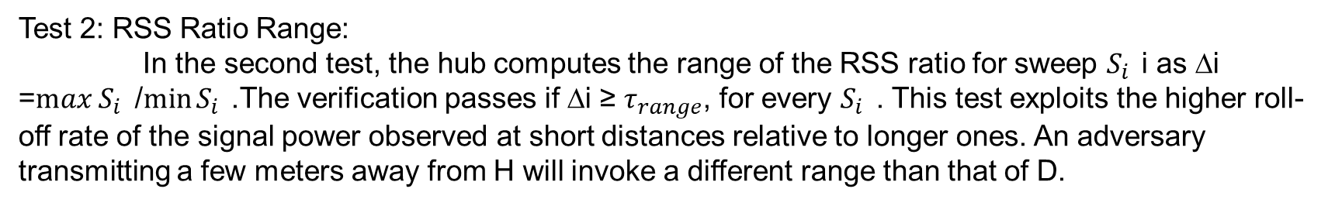
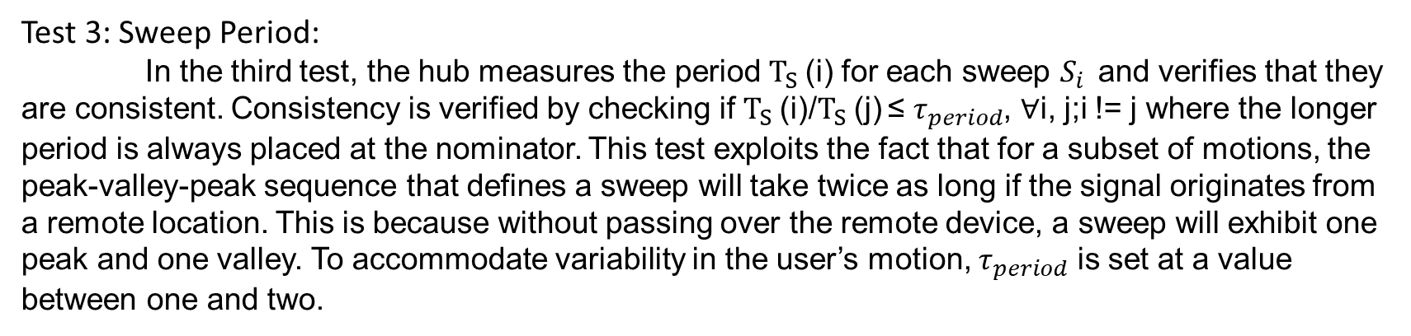
Test 2: RSS Ratio Range:
In the second test, the hub computes the range of the RSS ratio for sweep $S_{i }$i as ∆i =$max S_{i }$ /$\min{S_{i }}$.The verification passes if ∆i ≥ $τ_{range}$, for every $S_{i }$ . This test exploits the higher roll-off rate of the signal power observed at short distances relative to longer ones. An adversary transmitting a few meters away from H will invoke a different range than that of D.
Test 3: Sweep Period:
In the third test, the hub measures the period $T_{S}$(i) for each sweep $S_{i }$ and verifies that they are consistent. Consistency is verified by checking if $T_{S}$(i)/$T_{S}$(j) ≤ $τ_{period}$, ∀i, j;i != j where the longer period is always placed at the nominator. This test exploits the fact that for a subset of motions, the peak-valley-peak sequence that defines a sweep will take twice as long if the signal originates from a remote location. This is because without passing over the remote device, a sweep will exhibit one peak and one valley. To accommodate variability in the user’s motion, $τ_{period}$ is set at a value between one and two.
Notes:
Test2 將hub端計算後的∆i (也就是$max S_{i }/\min{S_{i }}$)，檢查看每個是否都高於$τ_{range}$，
這項測試顯示出signal power的roll-off rate (衰減速率) 在短距離比較高。 所以當一個攻擊者在離helper幾米遠時，攻擊者的range 與 D 的range是有差別的。
Test3 要去計算每個sweep $S_{i }$的 period，並判斷sweep是否連續，判定方法是所有$T_{S}($i)/$T_{S}(j$)<=$τ_{period}$(介於1~2), 大的放分子。這項test是檢驗若一個remote的裝置傳訊號，他的sweep會比一般長2倍 (一個sweep是peak-valley-peak sequence )

Slide 12
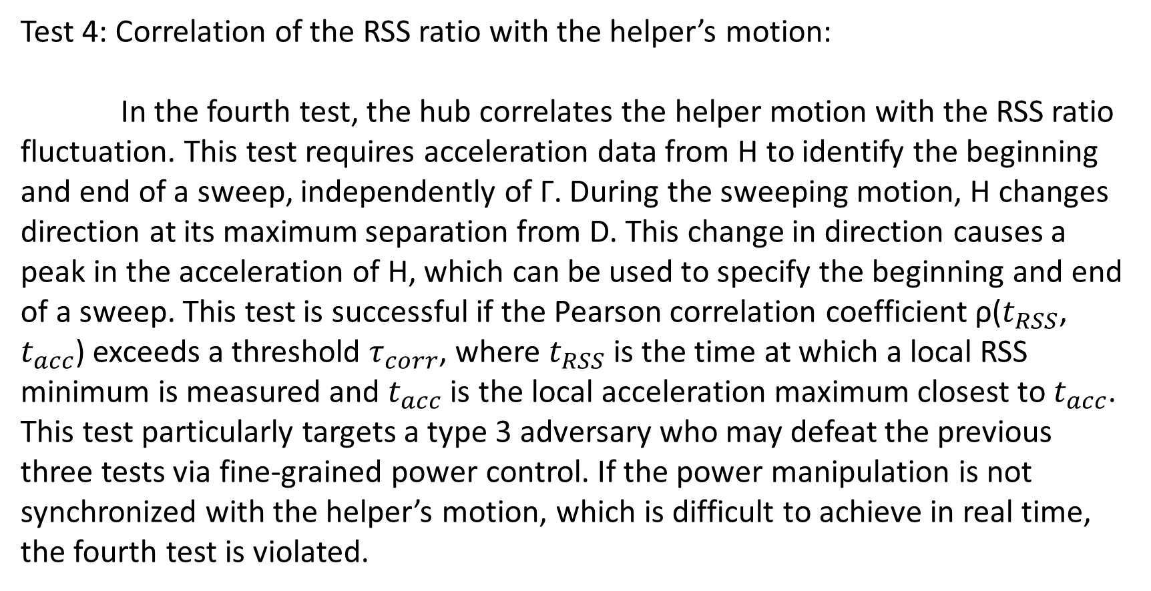
Test 4: Correlation of the RSS ratio with the helper’s motion:
In the fourth test, the hub correlates the helper motion with the RSS ratio fluctuation. This test requires acceleration data from H to identify the beginning and end of a sweep, independently of Γ. During the sweeping motion, H changes direction at its maximum separation from D. This change in direction causes a peak in the acceleration of H, which can be used to specify the beginning and end of a sweep. This test is successful if the Pearson correlation coefficient ρ($t_{RSS}$, $t_{acc}$) exceeds a threshold $τ_{corr}$, where $t_{RSS}$ is the time at which a local RSS minimum is measured and $t_{acc}$ is the local acceleration maximum closest to $t_{acc}$. This test particularly targets a type 3 adversary who may defeat the previous three tests via fine-grained power control. If the power manipulation is not synchronized with the helper’s motion, which is difficult to achieve in real time, the fourth test is violated.
Notes:
該測試需要來自H的加速度數據來確定sweep的開始和結束。當H在sweep動作時改變方向會讓整個加速度產生一個峰值，我們可以藉此來知道sweep 的開始與結束。若Pearson 相關係數ρ($t_{RSS}$, $t_{acc}$) 超過一個threshold $τ_{corr} 則通過$測試。$t_{RSS}是$測到最小值RSS的時間，$t_{acc}$ 是最接近$t_{acc}$的局部加速度最大值。這項測試特別針對前三項都通過測試的攻擊者，因為可能可以透過粒度功率控制來通過前三者，但如果力量操縱與helper motion不同步，將會違反第四項測試。

